Slide 1
Introduction to
Neural Networks

Slide 2
Outline
Introduction to Neural Networks
What is Neural Networks?
Feed Forward Networks
Learning through Back-propagation
Applications of Neural Networks
Hand Written Character Recognition

Slide 3
Background
- Neural Networks are :
Inspired by brain
Created using very crude approximation
That’s why called Artificial Neural Networks
- Desire to produce artificial systems capable of
sophisticated computations similar to the human brain.

Slide 4
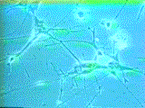
How Does the Brain Work ? (1)
NEURON
- The cell that perform information processing in the brain.
- Fundamental functional unit of all nervous system tissue.

Slide 5
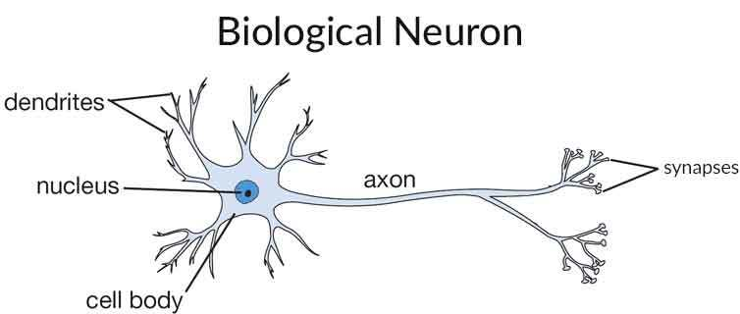
How Does the Brain Work ? (2)
Each consists of :
DENDRITES, AXON, and SYNAPSE.

Slide 6
Brain vs. Digital Computers (1)
Computers require hundreds of cycles to simulate
a firing of a neuron.
- The brain can fire all the neurons in a single step.
Parallelism
- Serial computers require billions of cycles to
perform some tasks but the brain takes less than
a second.
e.g. Face Recognition
Presented by Martin Ho, Eddy Li, Eric Wong and Kitty Wong - Copyright© 2000

Slide 7
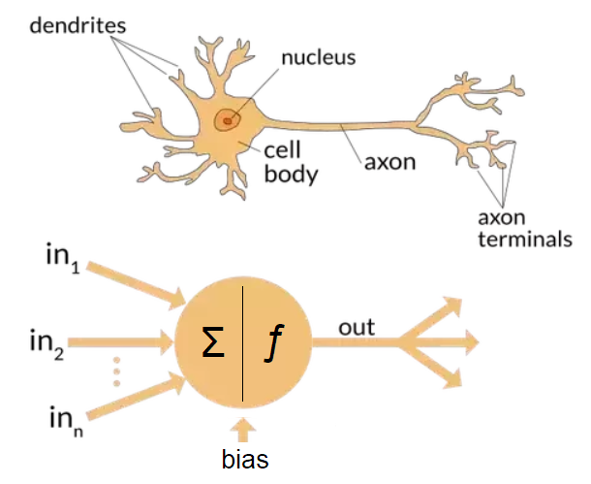
Single Artificial Neuron
Presented by Martin Ho, Eddy Li, Eric Wong and Kitty Wong - Copyright© 2000

Slide 8
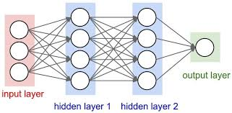
Artificial Neural Network

Slide 9

Artificial Neural Network Types

Slide 10
Planning in building a Neural Network
Decisions on:
- The number of units to use.
- The type of units required.
- Connection between the units.

Slide 11
Learning Steps
- STEP ONE: initialize the weights and biases.
The weights in the network are initialized to random numbers from the interval [-1,1].
Each unit has a BIAS associated with it
The biases are similarly initialized to random numbers from the interval [-1,1].
STEP TWO: feed the training sample.
Train until accuracy or some predefined criteria meet

Slide 12
STEP THREE: Propagate the inputs forward; we compute the net input and output of each unit in the hidden and output layers.
STEP FOUR: back propagate the error.
STEP FIVE: update weights and biases to reflect the propagated errors.
STEP SIX: terminating conditions.

Slide 13
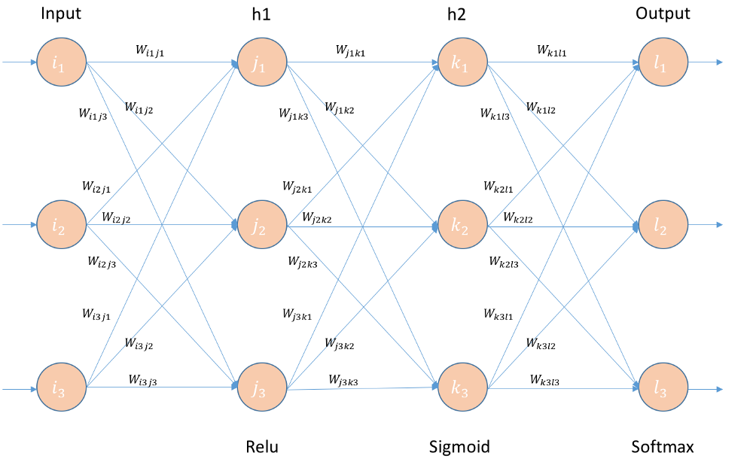
Example

Slide 14
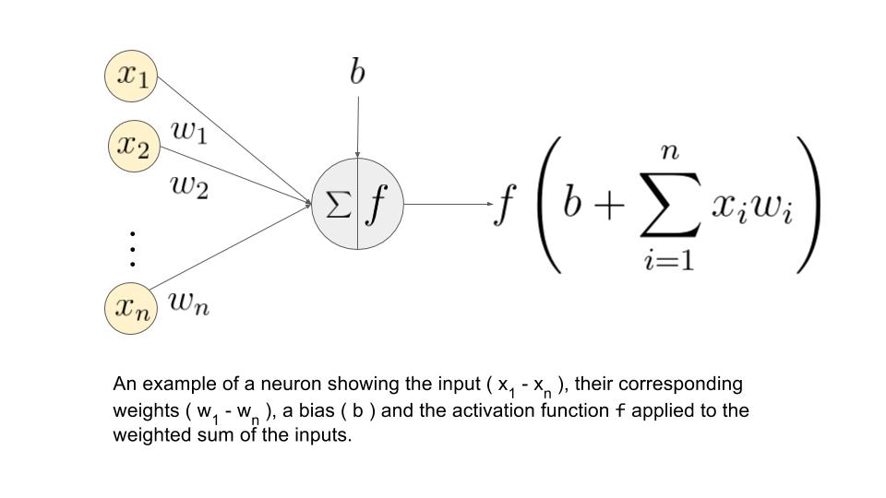
Basic Unit Functioning

Slide 15
Activation Functions
- Use different functions to obtain different models.
- 3 most common choices :
1) Step function
2) Sign function
3) Sigmoid function
- An output of 1 represents firing of a neuron down the
axon.
Presented by Martin Ho, Eddy Li, Eric Wong and Kitty Wong - Copyright© 2000

Slide 16
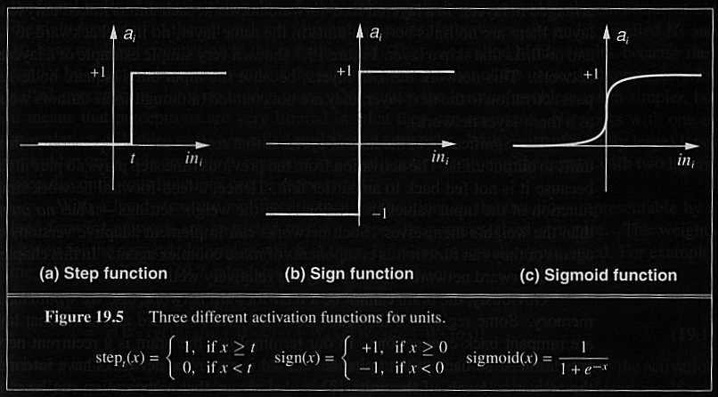
3 Activation Functions
Presented by Martin Ho, Eddy Li, Eric Wong and Kitty Wong - Copyright© 2000

Slide 17
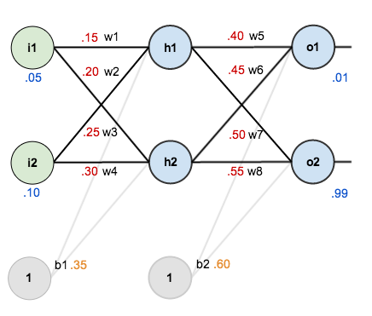
Example Forward Pass
given inputs 0.05 and 0.10, we want the neural network to output 0.01 and 0.99.

Slide 18
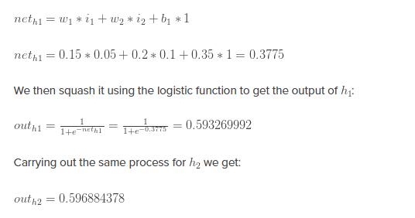
To begin, lets see what the neural network currently predicts given the weights
and biases above and inputs of 0.05 and 0.10. To do this we’ll feed those inputs
forward though the network. We figure out the total net input to each hidden
layer neuron, squash the total net input using an activation function
(here we use the logistic function), then repeat the process with the
output layer neurons. how we calculate the total net input for

Slide 19
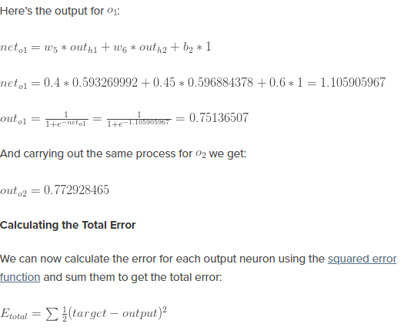
We repeat this process for the output layer neurons, using the output from the hidden layer neurons as inputs.

Slide 20
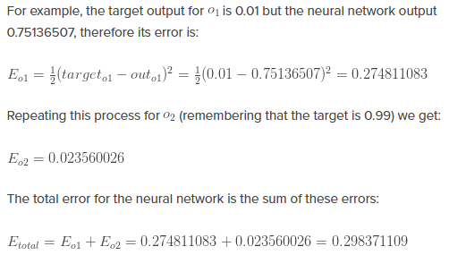

Slide 21
Introduction to Backpropagation
- In 1969 a method for learning in multi-layer network,
Backpropagation, was invented by Bryson and Ho.
- The Backpropagation algorithm is a sensible approach
for dividing the contribution of each weight.
- Works basically the same as perceptrons
Presented by Martin Ho, Eddy Li, Eric Wong and Kitty Wong - Copyright© 2000

Slide 22
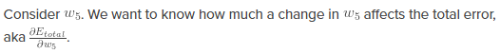
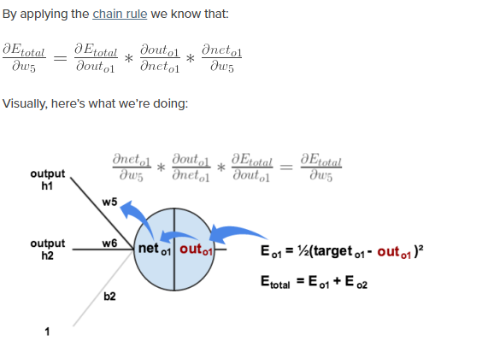
THE BACKWARD PASS
(Learning throughBack-propagation)
Our goal with back propagation is to update each of the weights in the network so that they cause the actual output to be closer the target output, thereby minimizing the error for each output neuron and the network as a whole.

Slide 23
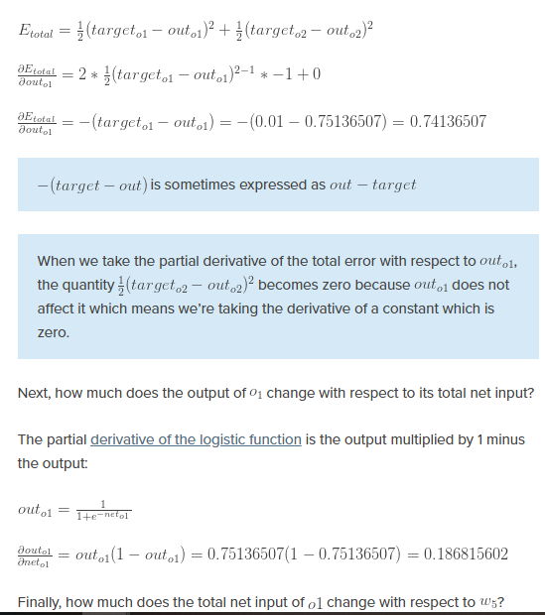
We need to figure out each piece in this equation.First, how much does the total error change with respect to the output?

Slide 24
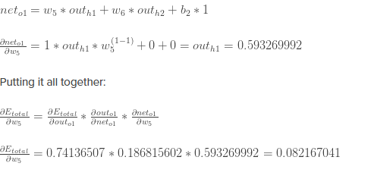
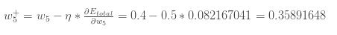
Likewise we will Find all the weights :
Lets do it
To decrease the error, we then subtract this value from the current
weight (optionally multiplied by some learning rate, eta,
which we’ll set to 0.5):

Slide 25
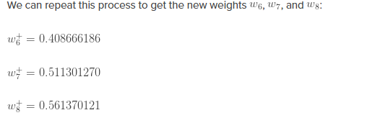

Slide 26
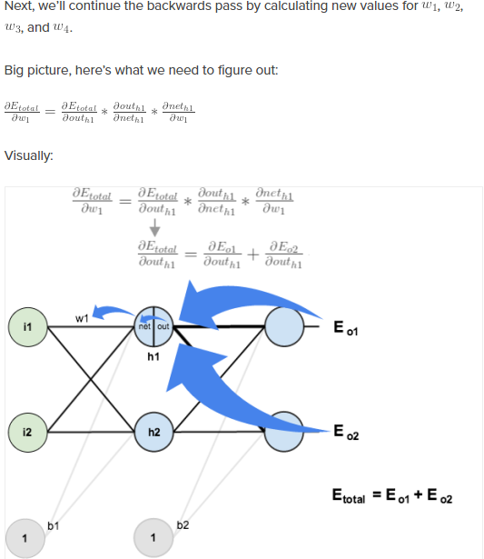
Hidden layer

Slide 27
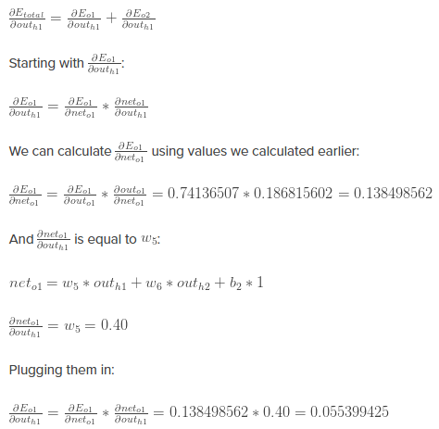
WE will use a similar process as we did for the output layer but slightly different to
account for the fact that the output of each hidden layer neuron contributes to the
output (and therefore error) of multiple output neurons.

Slide 28
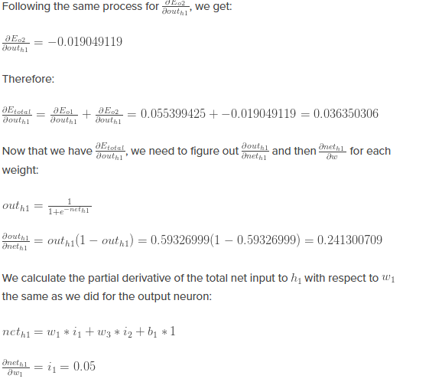

Slide 29
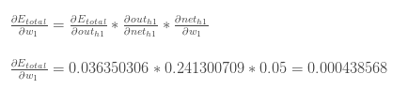
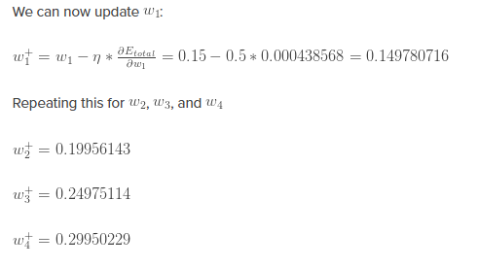
All set putting all things together we get
Its done .Yes we have update all our weights When we fed forward the 0.05 and 0.1
inputs originally, the error on the network was 0.298371109. After this first
round of backpropagation, the total error is now down to 0.291027924.
It might not seem like much, but after repeating this process 10,000 times, for example,
the error plummets to 0.0000351085. At this point, when we feed forward 0.05 and 0.1
, the two outputs neurons generate 0.015912196 (vs 0.01 target) and 0.984065734 (vs 0.99 target).

Slide 30
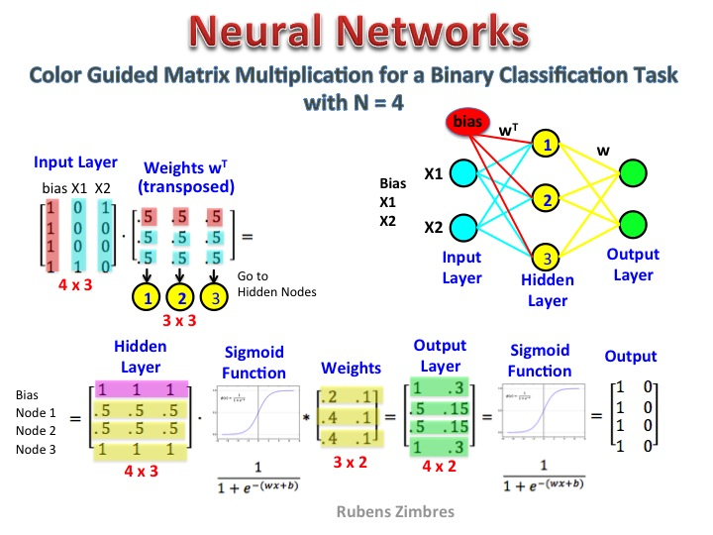

Slide 31
Classification by Back propagation
Back Propagation learns by iteratively processing a set of training data (samples).
For each sample, weights are modified to minimize the error between network’s classification and actual classification.

Slide 32
Update weights and biases
We are updating weights and biases after the presentation of each sample.
This is called case updating.
Epoch --- One iteration through the training set is called an epoch.
Epoch updating ------------
Alternatively, the weight and bias increments could be accumulated in variables and the weights and biases updated after all of the samples of the training set have been presented.
Case updating is more accurate

Slide 33
Terminating Conditions
Training stops
All
in the previous epoch are below some threshold, or
The percentage of samples misclassified in the previous epoch is below some threshold, or
a pre specified number of epochs has expired.
In practice, several hundreds of thousands of epochs may be required before the weights will converge.

Slide 34
Applications-I
Handwritten Digit Recognition
Face recognition
Time series prediction
Process identification
Process control
Optical character recognition

Slide 35
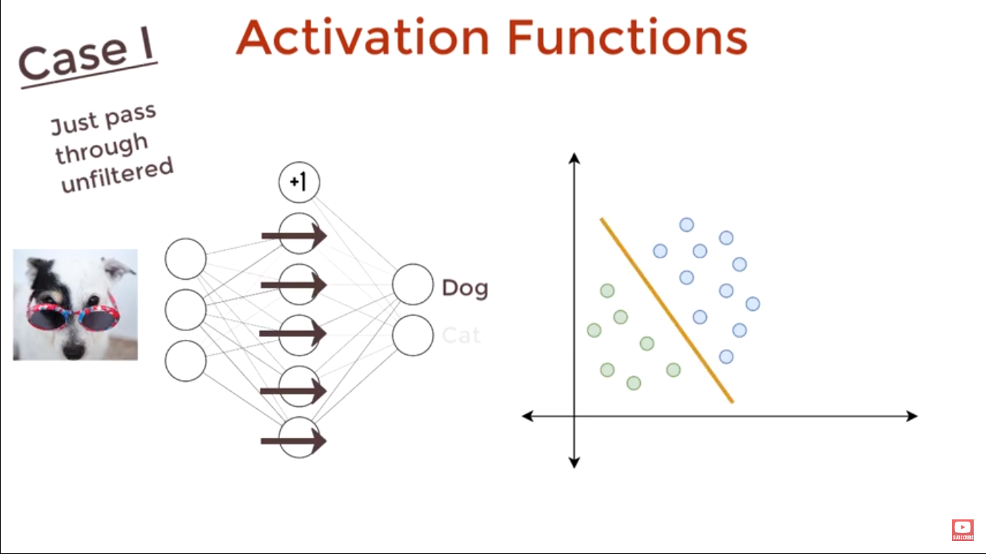
Activation Functions

Slide 36
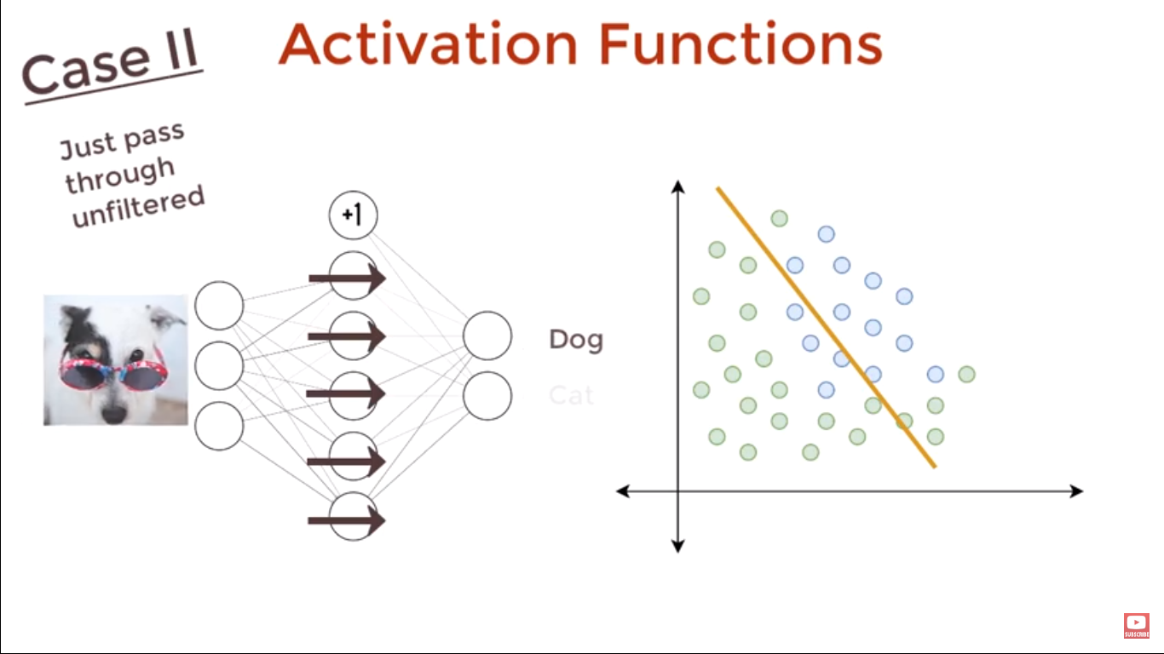

Slide 37
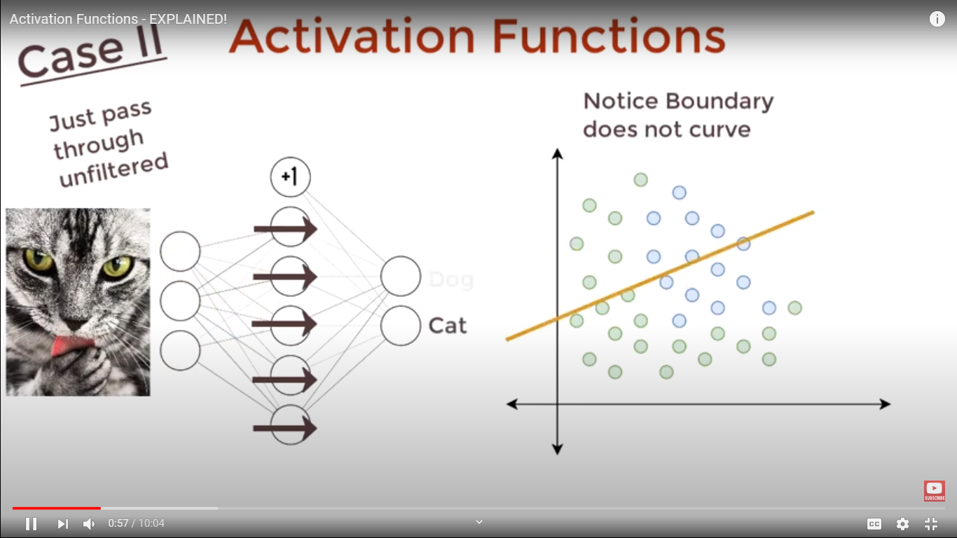

Slide 38
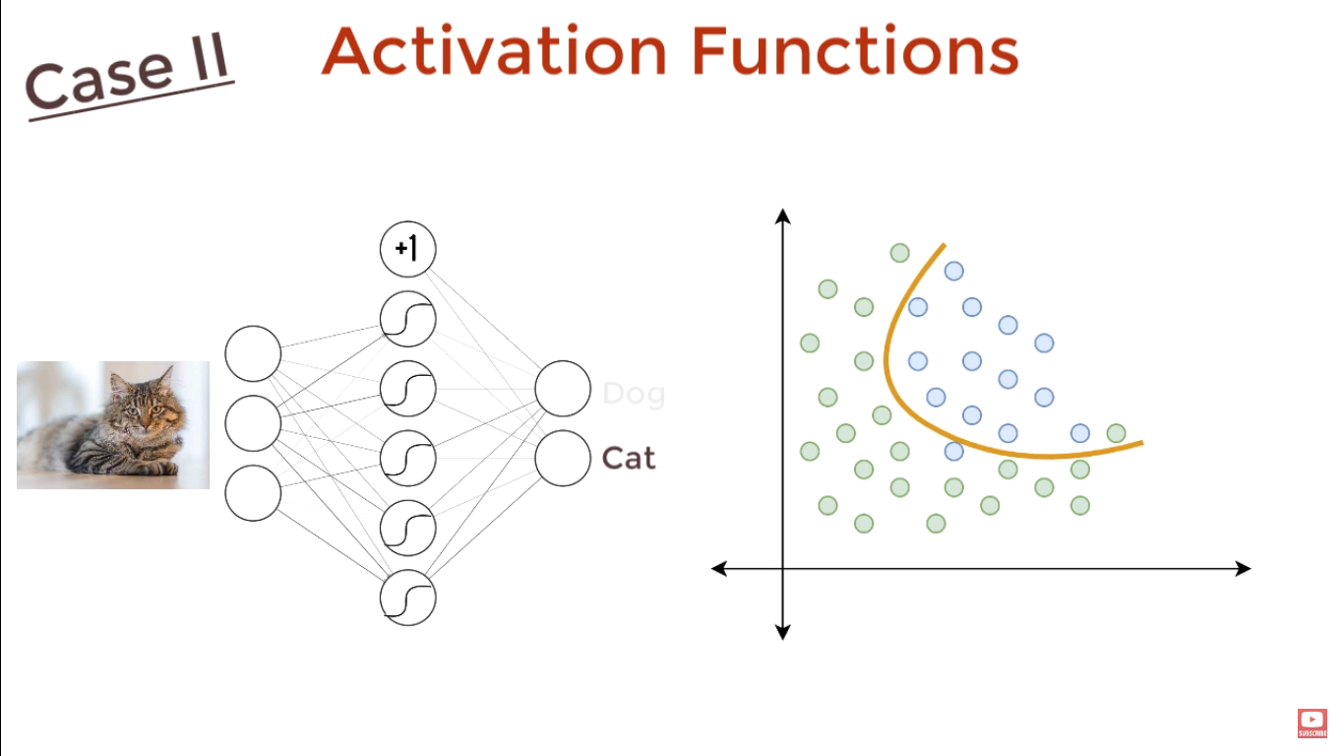

Slide 39
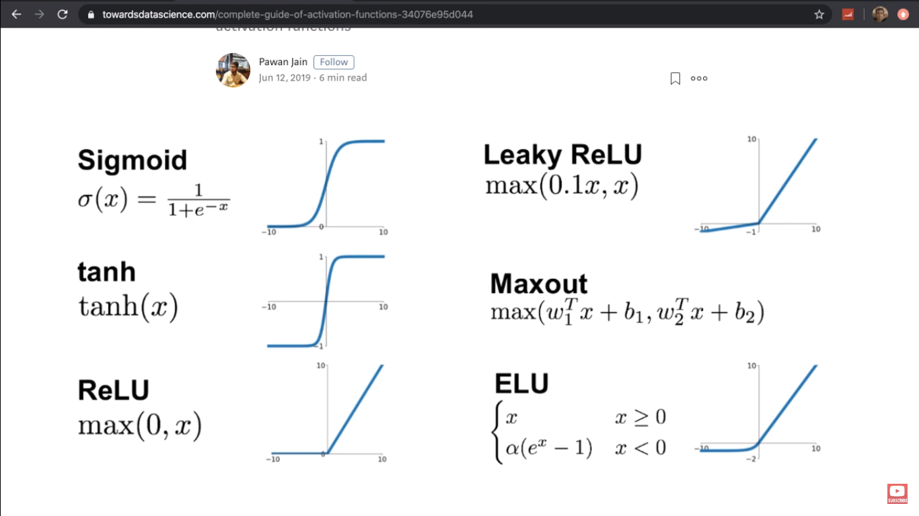

Slide 40
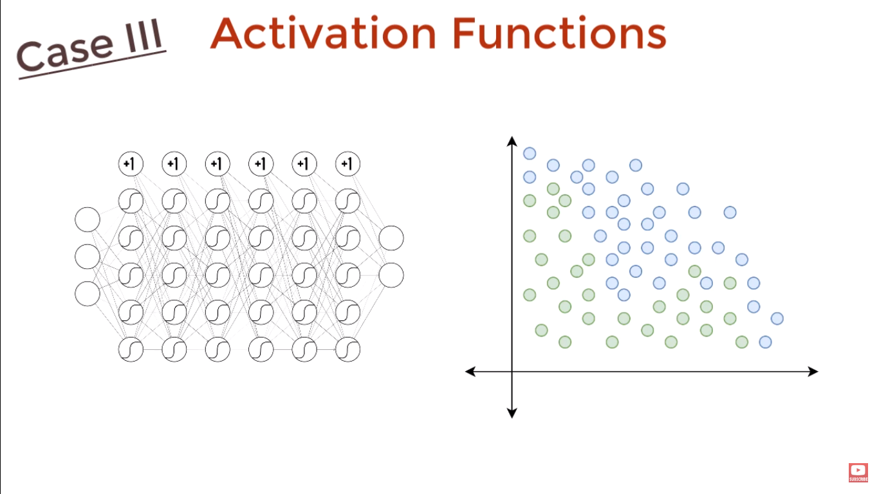

Slide 41
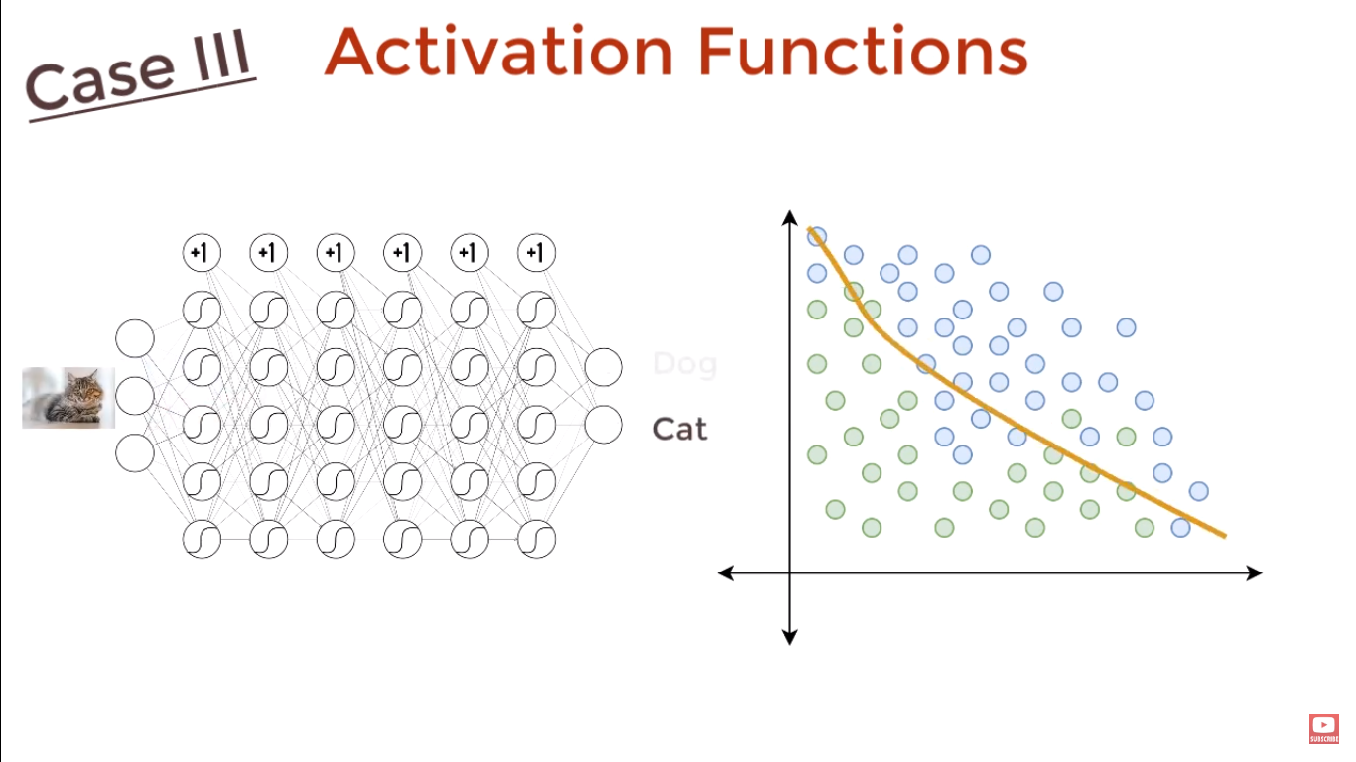

Slide 42
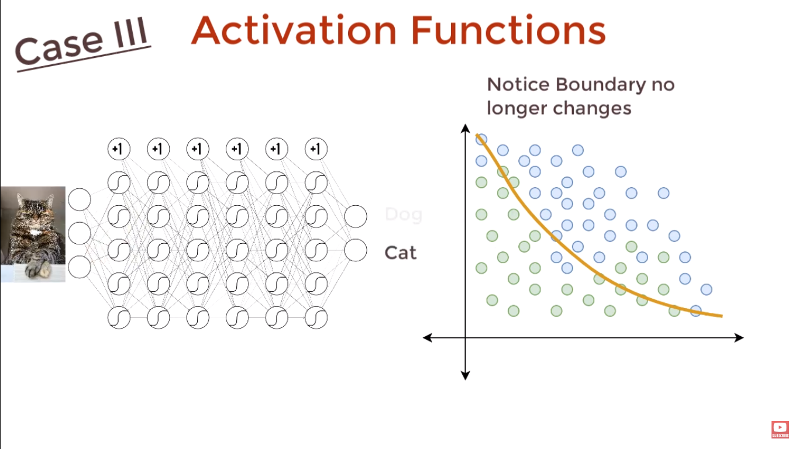

Slide 43
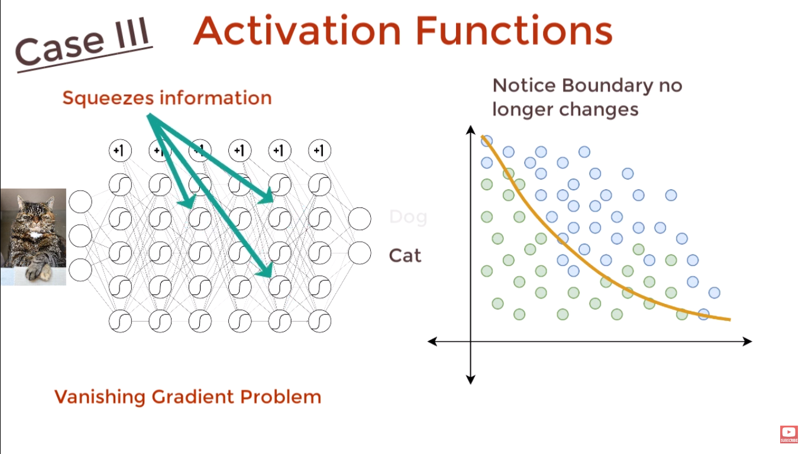

Slide 44
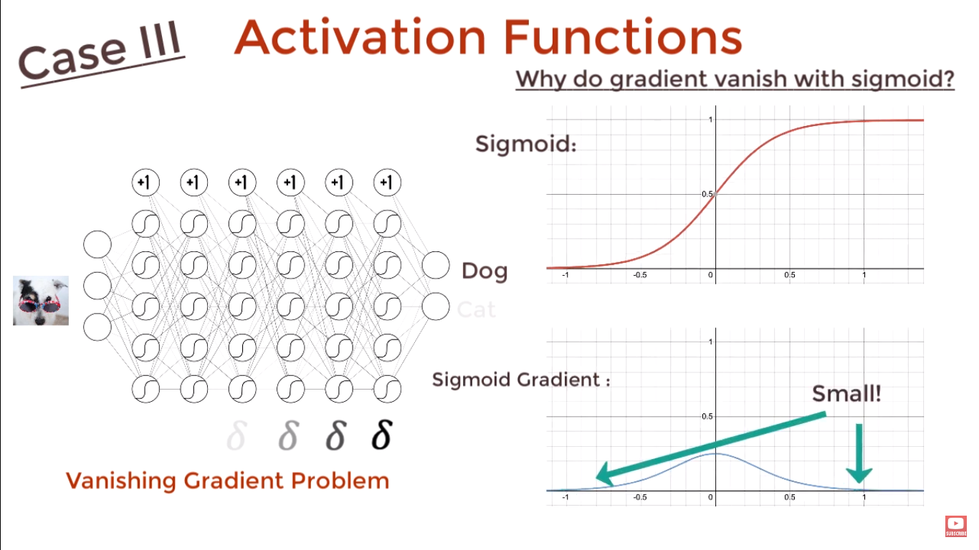

Slide 45
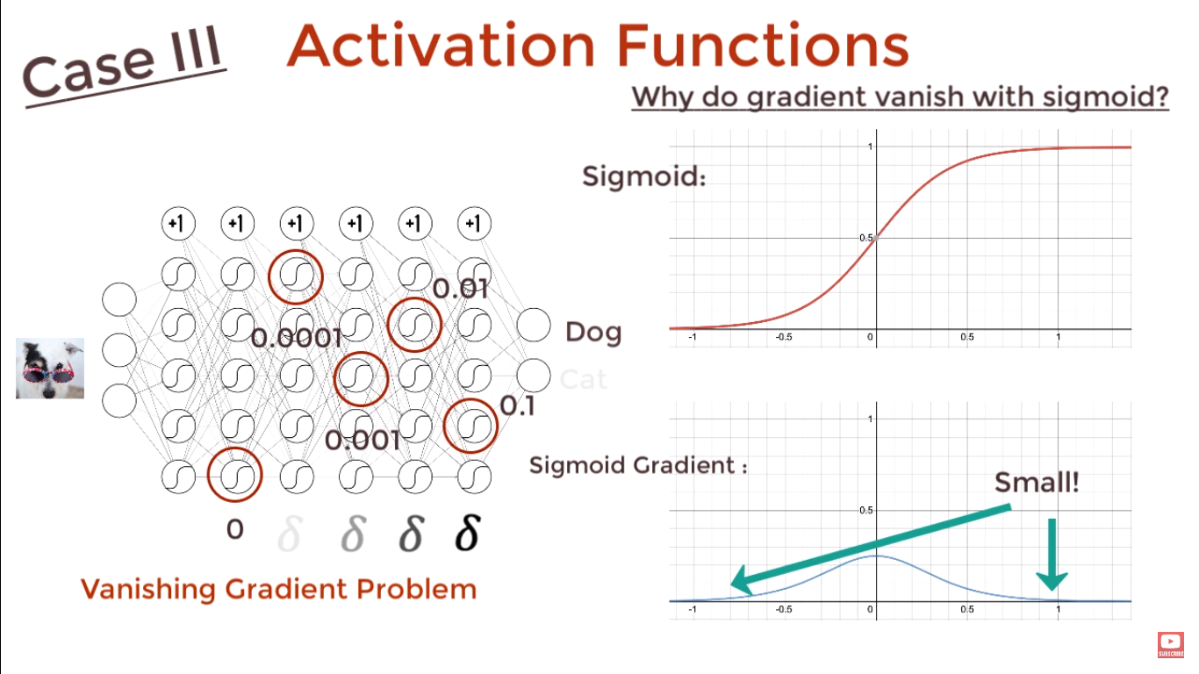

Slide 46
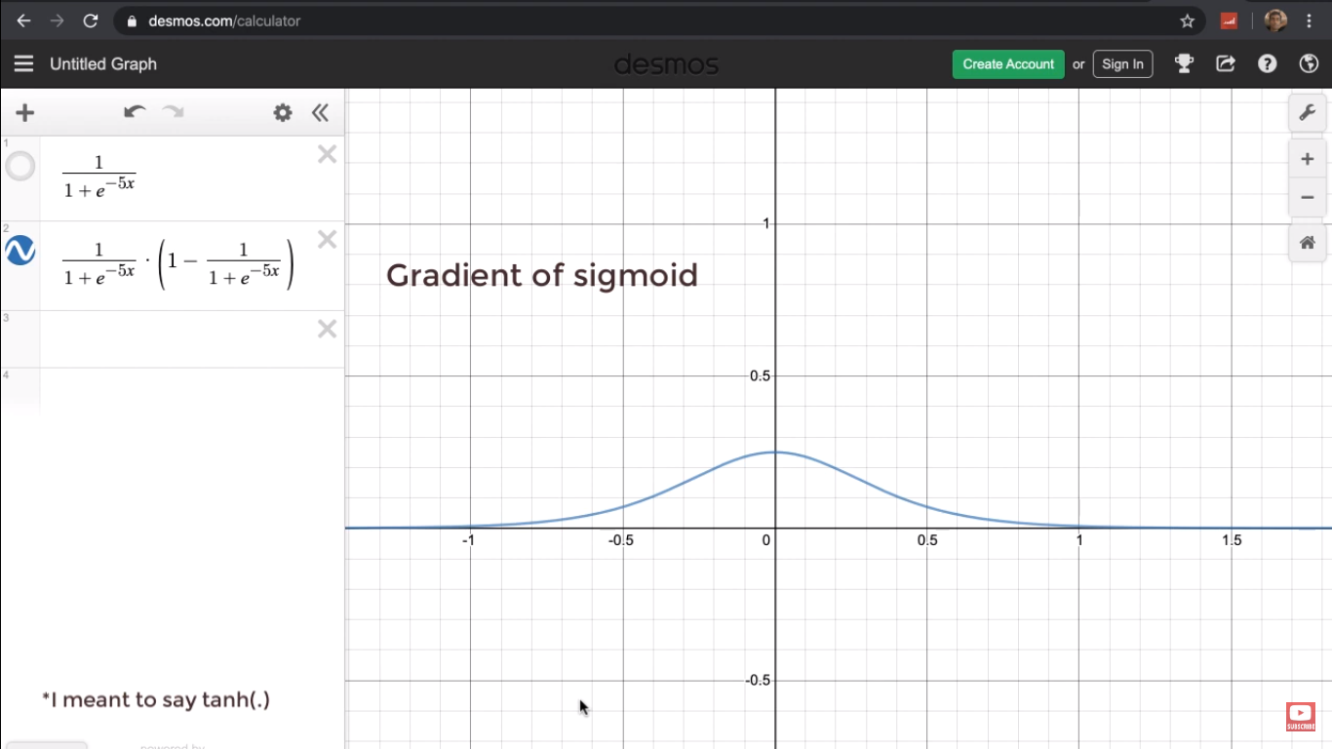

Slide 47


Slide 48
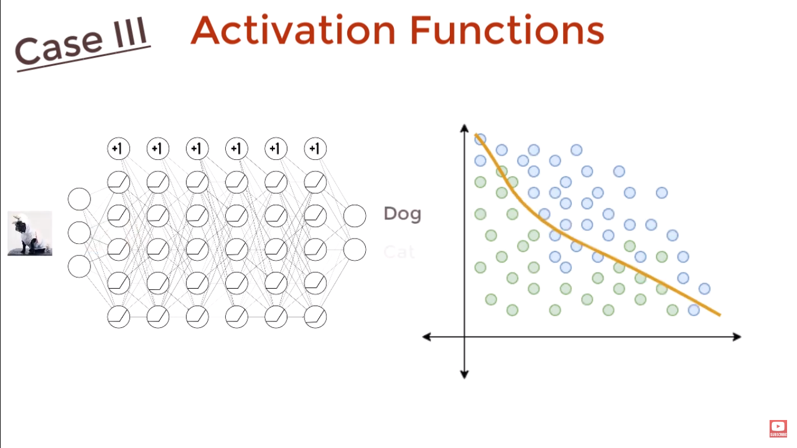

Slide 49
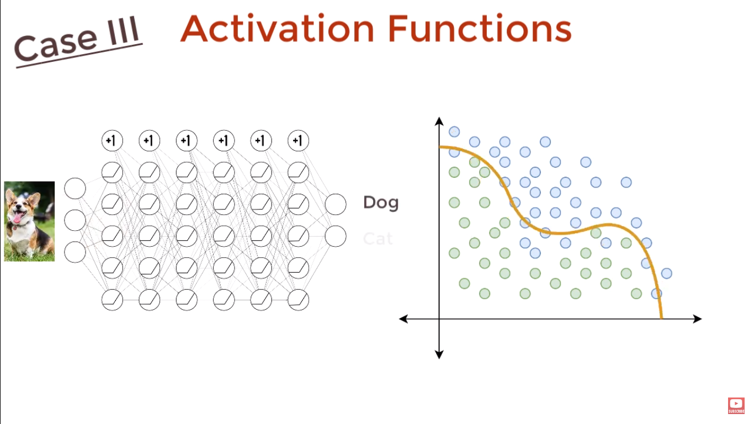

Slide 50
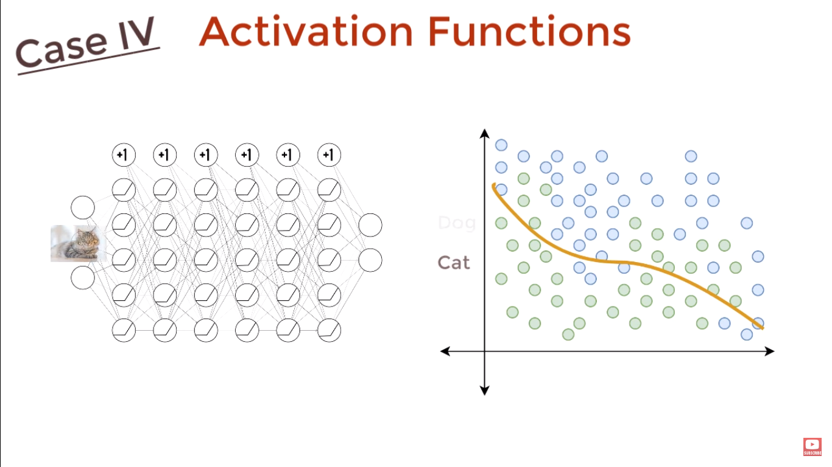

Slide 51
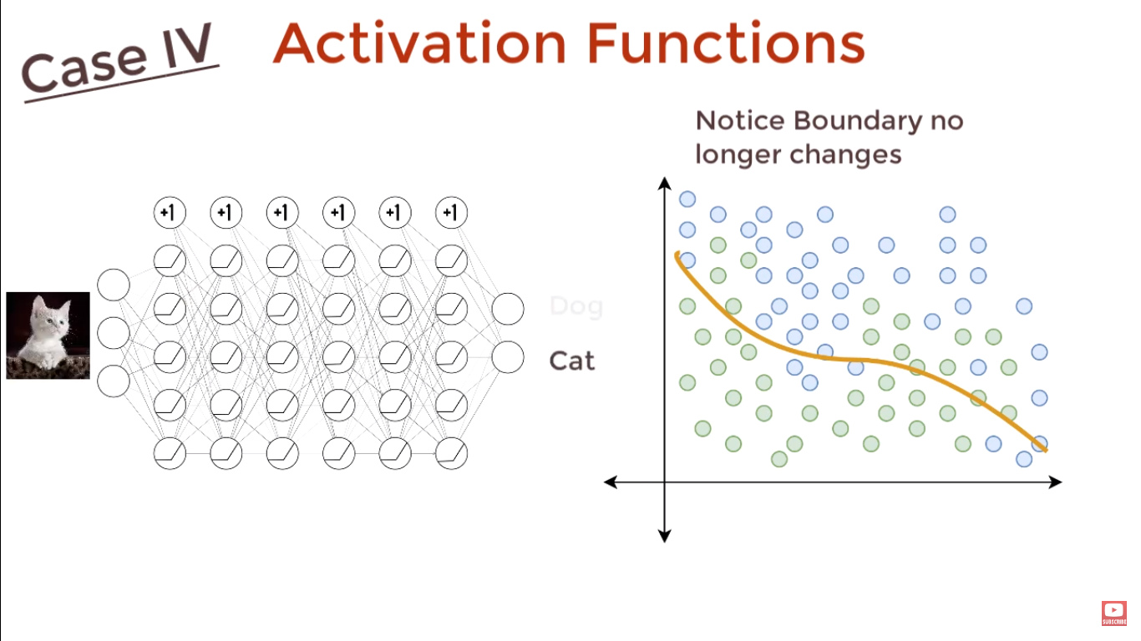

Slide 52
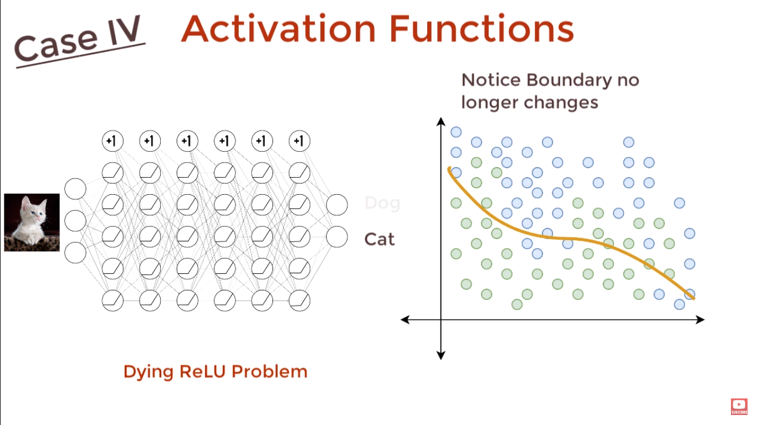

Slide 53
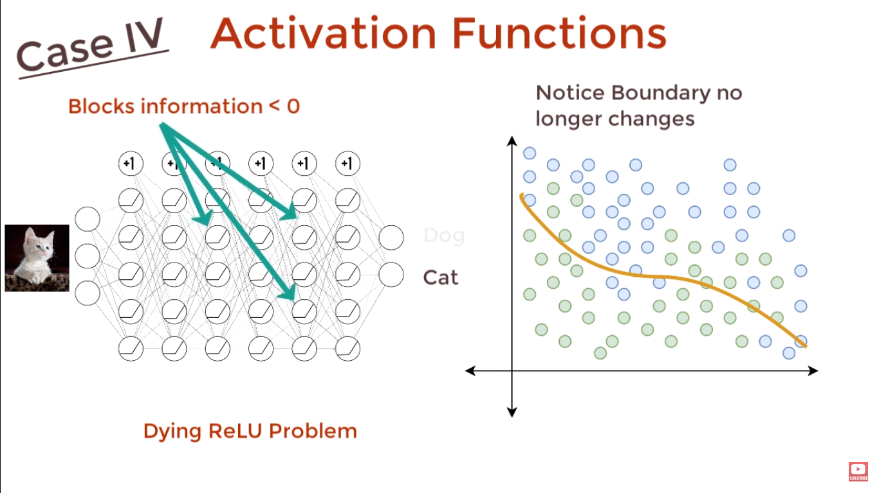

Slide 54
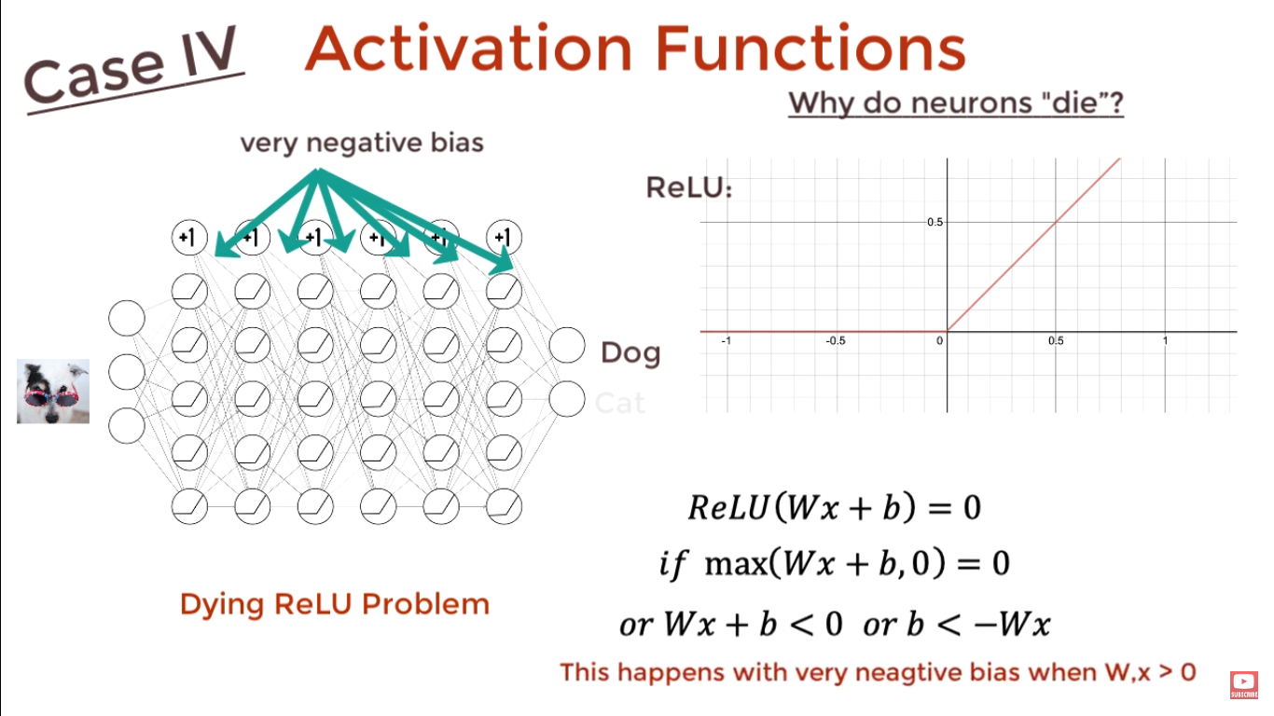

Slide 55
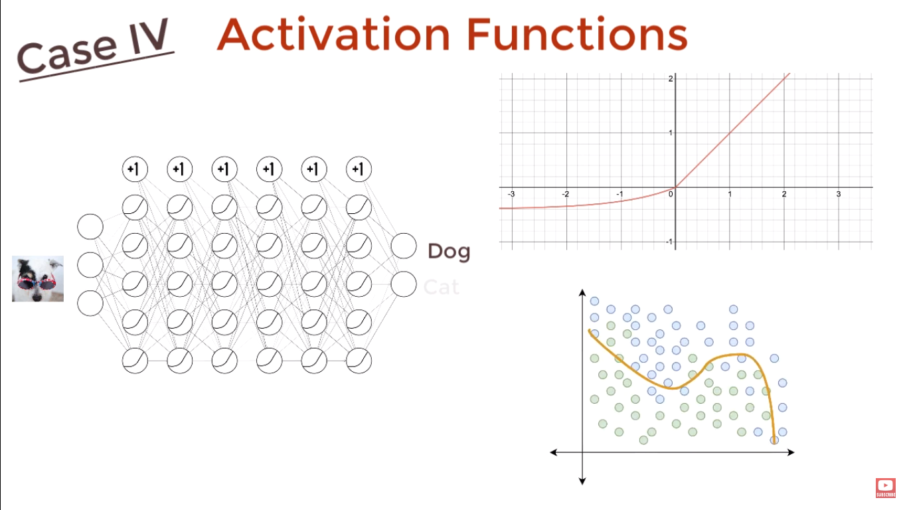

Slide 56
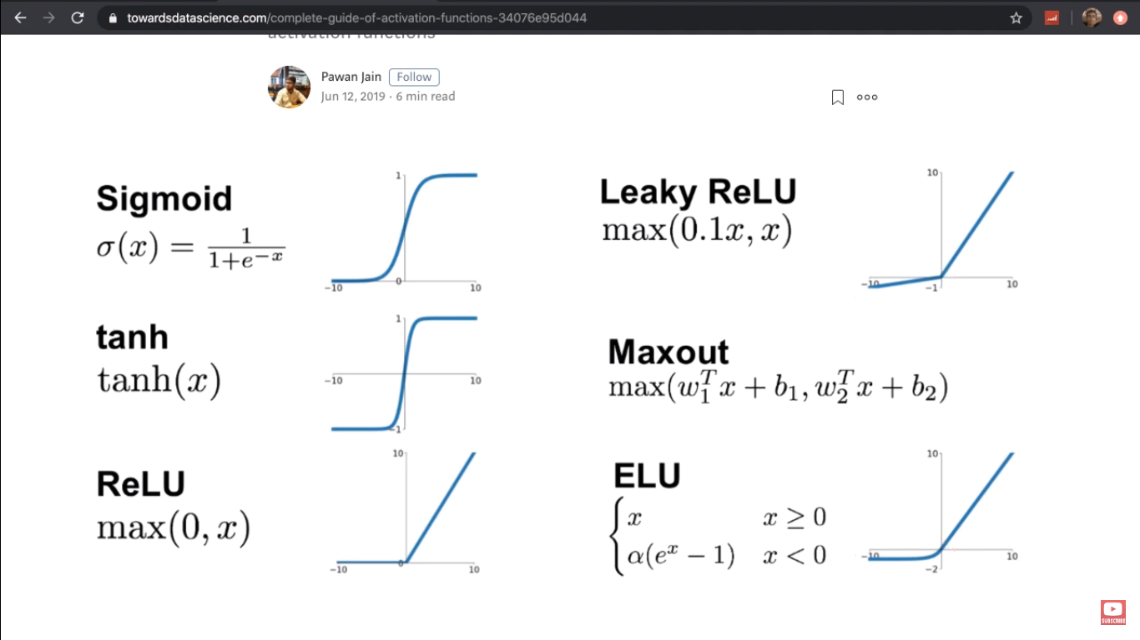

Slide 57
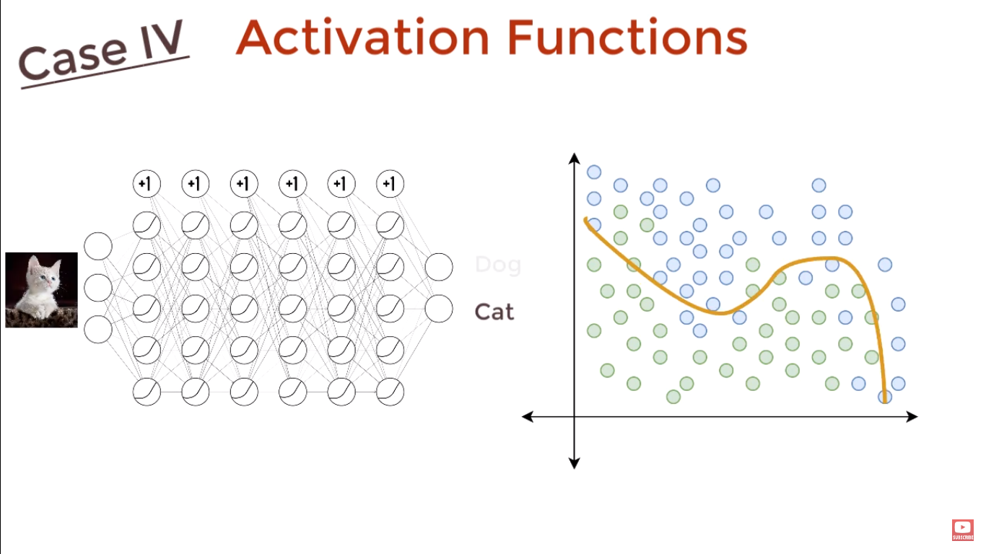

Slide 58
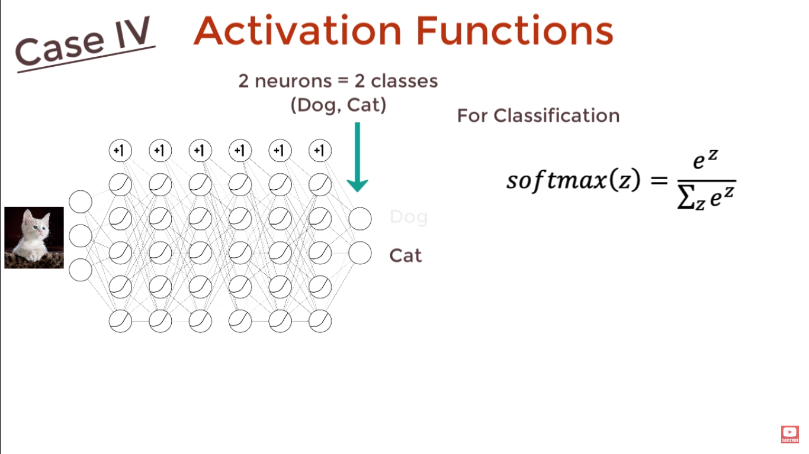

Slide 59
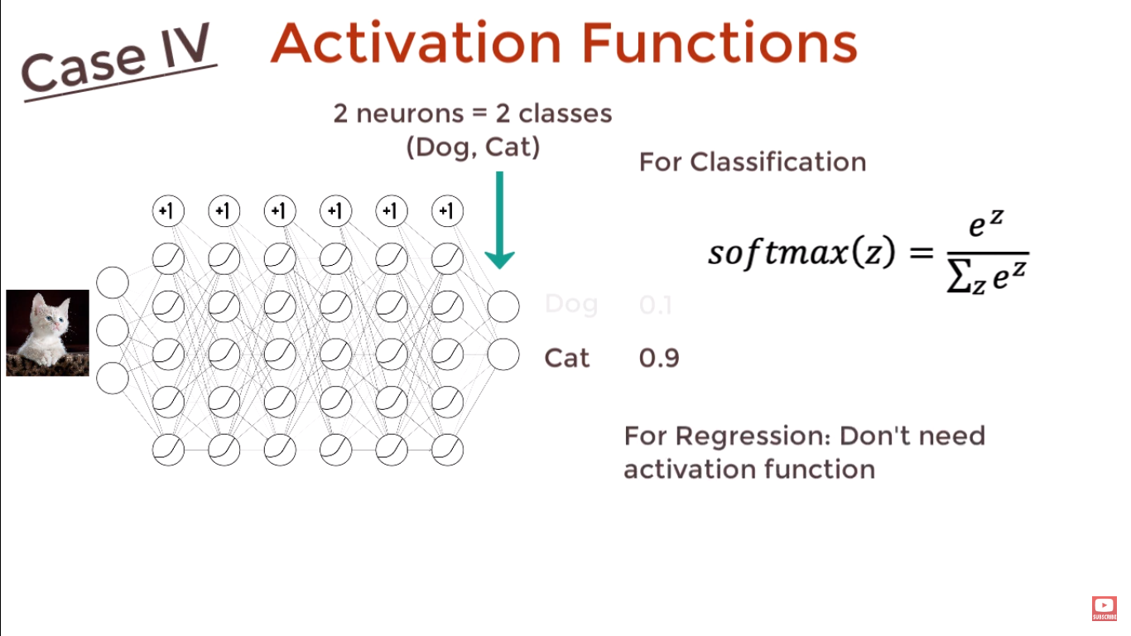

Slide 60
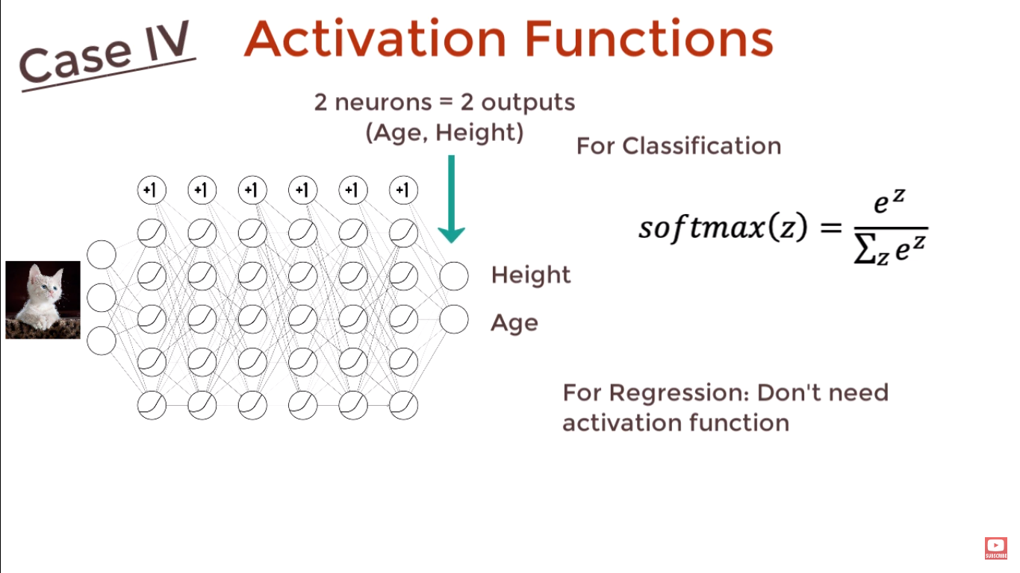

Slide 61
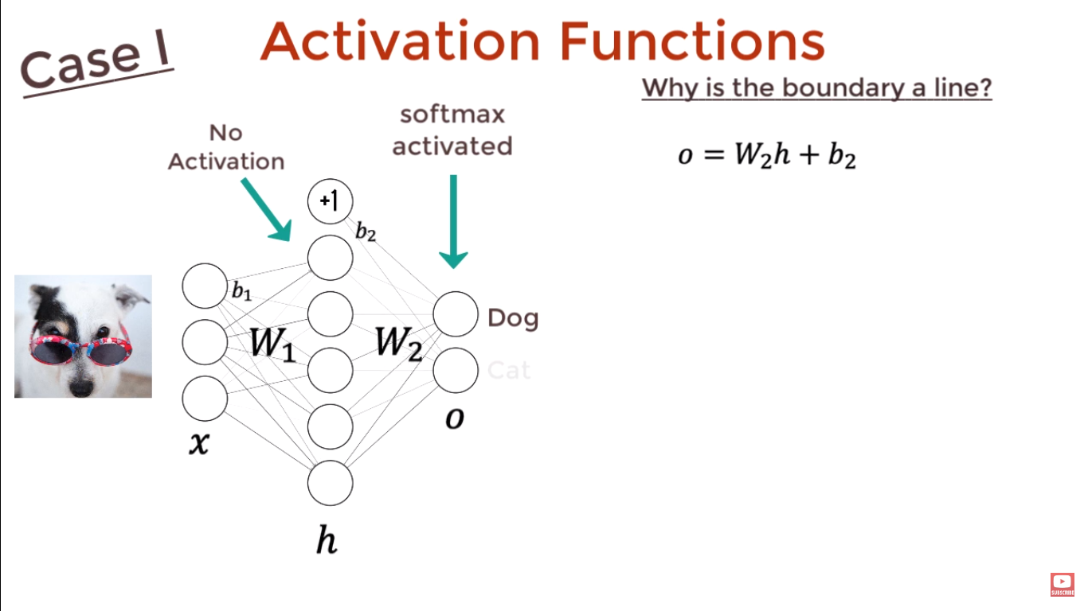

Slide 62
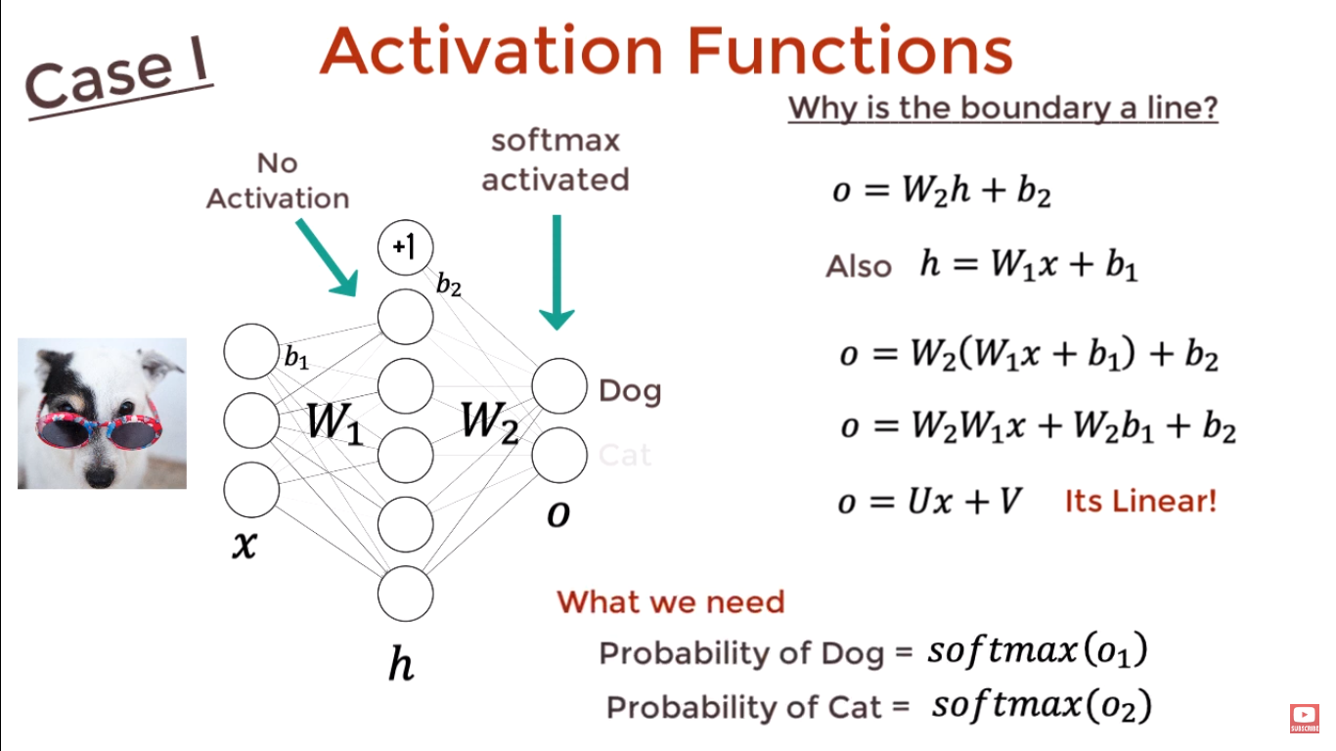

Slide 63


Slide 64
Loss Functions
Regression
Classification

Slide 65


Slide 66


Slide 67


Slide 68


Slide 69


Slide 70


Slide 71


Slide 72


Slide 73


Slide 74


Slide 75


Slide 76


Slide 77


Slide 78


Slide 79


Slide 80


Slide 81
Evaluation Measures

Slide 82


Slide 83


Slide 84


Slide 85


Slide 86


Slide 87


Slide 88


Slide 89


Slide 90


Slide 91


Slide 92


Slide 93


Slide 94


Slide 95


Slide 96


Slide 97


Slide 98


Slide 99


Slide 100


Slide 101


Slide 102


Slide 103


Slide 104




Recall for Cat is the number of correctly predicted Cat photos (4) out of the number of actual Cat photos (4+1+1=6), which is 4/6=66.7%. This means that our classifier classified 2/3 of the cat photos as Cat.
In a similar way, we can calculate the precision and recall for the other two classes: Fish and Hen. For Fish the numbers are 66.7% and 20.0% respectively. For Hen the number for both precision and recall is 66.7%. Go ahead and verify these results. You can use the two images below to help you.

